Slide 1
Vocational course
Introduction in webdesigning
Topic : Types of tags in HTML
Submitted by :
PREETHIKA.MK
21BBAE040

Slide 2
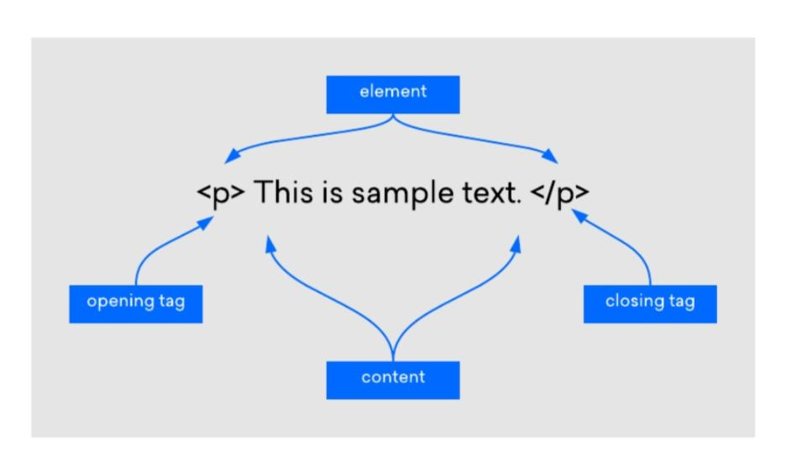
WHAT IS TAG ?
Tags can be defined as the instructions which are being directly embedded in the text of an HTML document. The types of tags used in the HTML document are responsible to tell a web browser to do something (follow the instruction) instead of just displaying text.
Example given below :

Slide 3
25 tags in HTML
<a> a for anchor, also known as a hyperlink, or simply a link.
<address> Contact information for the author. Alternatively, this could be general contact information for the website.
<area> Establishes areas in an image map. <area> is always used inside of <map>.
<article> The <article> tag is new in HTML5. This tag can be used to contain blog entries, forum posts, etc.
<base> Use to set a base URL.
<body> Establishes the body of an HTML document.
<br> Single line break. Think of br as short for break.
<caption> Placed just after <table>, used for table caption.
<col> Specify properties of a <col> within a <colgroup>
<colgroup> Essentially a group of columns.
<data> Used for script friendly data.

Slide 4
<del> Mark text as deleted without actually deleting it. This will typically be rendered as a strikethrough.
<dialog> Dialog box.<h1> Level 1 heading, the headline or title of a page. <h2> Level 2 heading, the subtitles of a page. <h3> Level 3 heading. <h4> Level 4 heading. <h5> Level 5 heading. <h6> Level 6 heading. <head> The head section. Used mostly for metadata. <header> Not to be confused with <head>, <header> typically contains introductory content and layout that goes above the body. <hgroup> Used for grouping <h1>, <h2>, <h3>, etc., tags together. Useful for multilevel headings. <hr> This can be used for separating text within a paragraph. Typically renders as a horizontal line running across the page. <html> The root level tag of an HTML document. All other HTML tags go inside the HTML tag.

Slide 5
<img> For displaying images on a webpage. Example: <img src=“image.png”>
<p> Paragraph. Enclose paragraphs in an article within <p> tags.
<sub> For displaying subscript. Useful for math, especially in conjunction with <sup> (superscript).
<sup> For displaying superscript. Useful for math, especially in conjunction with <sub> (subscript).
<title> The title of an HTML document

Slide 6
Thankyou !
Submitted by :
PREETHIKA.MK
21BBAE040

